Slide 1

Recall system Analysis
Presented By:
Richa Patel, Surbhi Patel, Dharmik Patel, Raj Bhalodwala

Slide 2
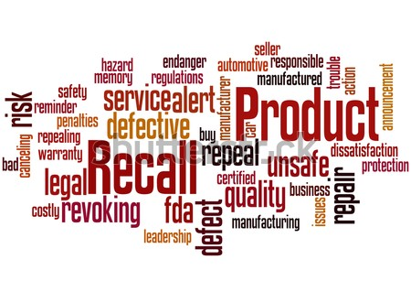
Agenda
Introduction
About the dataset
Five c’s
Problem statement
Methodology
Data cleaning
Data visualization
Challenges
ML Models
Tableau visualizations

Slide 3

Introduction
The FDA (food and drug administration) recall system is a process that the agency uses to protect the public health by removing or correcting products that are found to be unsafe or violate federal laws from the market.
This system applies to a wide range of products including foods, drugs, medical devices, cosmetics, and tobacco products.
Once a recall is initiated, the FDA works with the responsible company to determine the best course of action. This may include removing the product from the market, correcting the issue, or providing consumers with information about the product's safety. The FDA also works to ensure that the public is informed about the recall and has access to information about the potential risks associated with the product

Slide 4
About the Dataset
This dataset is for recall-system prediction from the U.S. Food and drug administration website. This is the latest data which has an information about different product type such as Biologics, Devices, Drugs, Food/Cosmetics, Tobacco, Veterinary and their status with the reason of why they are recalled from the specific state.
Data Quality:
Data itself is clear as it does not have any missing values and we can easily see from the heat map that there are not too many co-relation between the attributes.
Data Fitness:
The FDA is responsible for caring the community health by ensuring the safety, efficacy, and safety of human and veterinary drugs, biological products, and medical devices. The dataset provides information on product recalls initiated by companies and manufacturers that are regulated by the FDA.

Slide 5
FIVE C’s
Consent: We will be analyzing the FDA recall data solely for the purpose of our project and not for any other reason.
Clarity: Our project team will request the FDA recall data through official channels, clearly stating the goal of our analysis.
Consistency: We will ensure consistency in our analysis of the FDA recall data throughout the project.
Control: All access and control of the FDA recall data analysis, will be limited to the project.
Consequences: As the FDA recall data contains information about potentially dangerous products, any potential data leak could pose a risk to public safety. However, since the data does not contain any personal information, the consequences would not directly impact any individuals or companies. We will take measures to ensure the security and privacy of the data throughout the project..

Slide 6
PROBLEM STATEMENT
The problem statement is to identify and analyze the reasons for product recalls in the food, medical devices, and other consumer goods industries and evaluate the effectiveness of the recall processes in ensuring public safety. The goal is to identify patterns and trends in recall data to inform regulatory and industry efforts to prevent future recalls and improve the overall safety of consumer products.

Slide 7
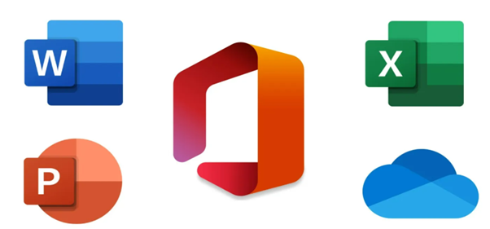



METHODOLOGY
• Data Collection
• Data Cleaning (Excel, Python)
• Data Visualization (Tableau, Python, Excel)
• Exploratory Data Analysis (Python)
• Creating dashboard (Tableau)
• Build and apply suitable algorithms(Python)

Slide 8
Data cleaning
Dataset itself is very clean and clear but there are couple of missing value that should be removed. Some columns are not important, so it was deleted, because we didn’t get any output from this columns.
All the columns have categorical values so, it can be transferred to numerical by using different technics

Slide 9

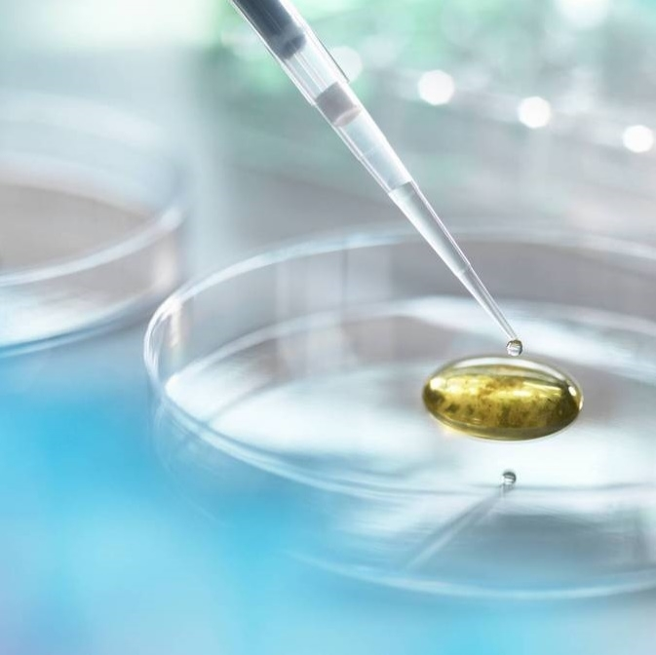
data Visualization

Slide 10
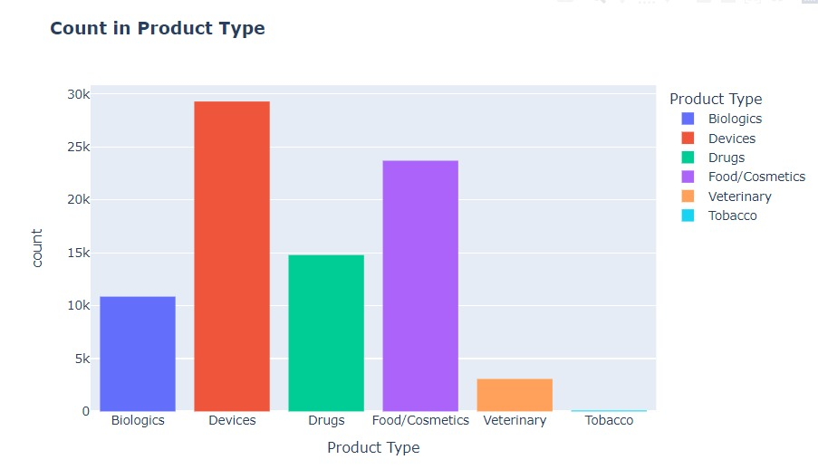
We can easily see which product types have the highest and lowest counts, which can inform business decisions or marketing strategies.

Slide 11
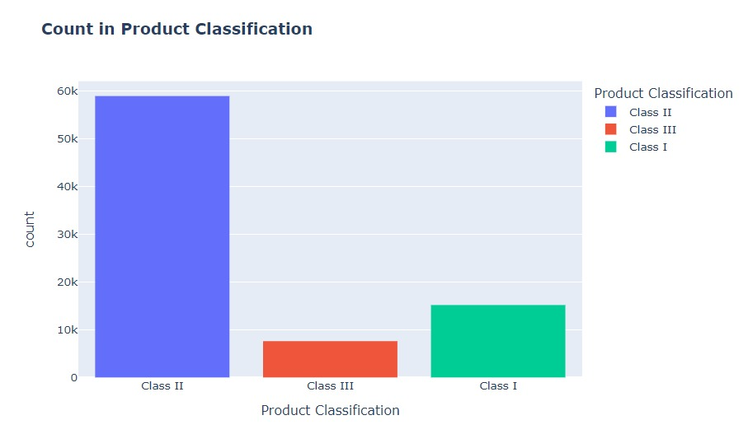
The histogram shows the product classification as three different classes, that is described as high risk, moderate risk and low risk class. The color-coding of the bars can also make it easier to compare the counts between different classifications.

Slide 12
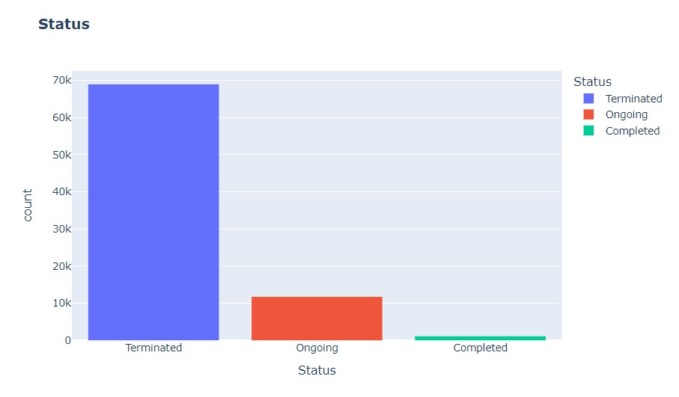
This chart can provide a quick summary of the status distribution in the dataset and can help inform decision-making processes.

Slide 13
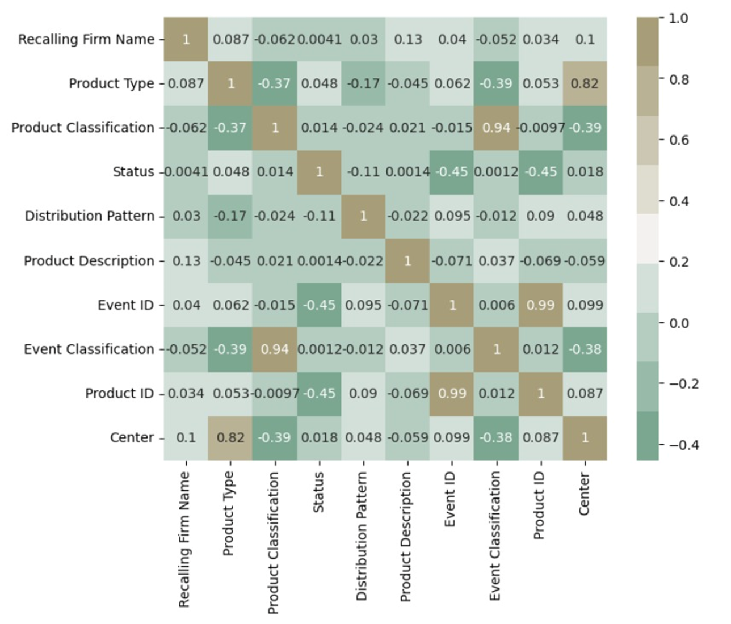
By creating this heatmap, we can gain insight into the pairwise correlation coefficients between the numerical columns of "data". This can help identify any strong positive or negative correlations between columns, which can inform feature selection or data preprocessing steps. The color map also makes it easy to visually distinguish between positive and negative correlations

Slide 14
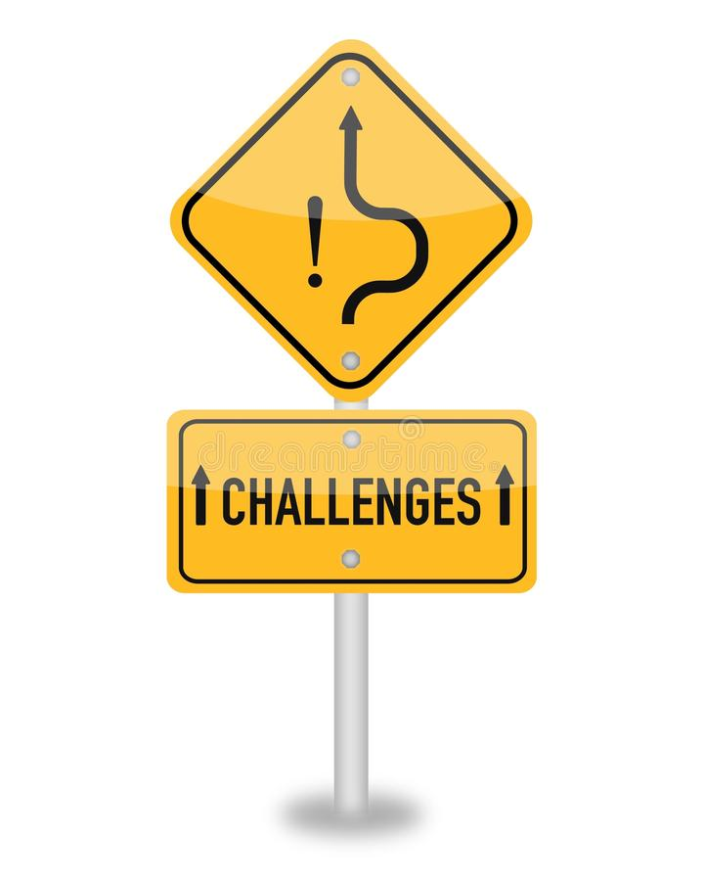
Challenges
Feature Selection
Creating Model with Categorical Variables
Creating SVM model

Slide 15
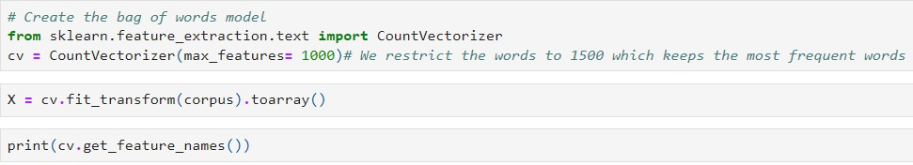
Bag of Words
The bag of words model is a way of representing text data as a numerical vector, where each element of the vector corresponds to a unique word in the text. The bag of words model is a simple and effective way of extracting features from text data, and is often used in natural language processing (NLP) applications such as text classification, sentiment analysis, and information retrieval.

Slide 16
Bag of Words
This code initializes a CountVectorizer object from the sklearn.feature_extraction.text module, which is used to create the bag of words model. The max_features parameter specifies the maximum number of features (i.e. words) to include in the model. In this case, the model will include at most 1000 unique words.To actually use this CountVectorizer object to create the bag of words model, we need to pass a list of strings (i.e. the sentences we want to analyze) to the fit_transform method

Slide 17
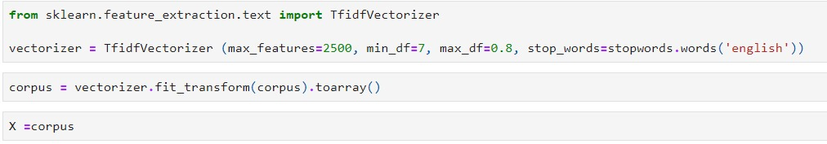
Tf-idf
TF-IDF stands for term frequency-inverse document frequency, and it is a technique commonly used in natural language processing (NLP) to weight the importance of words in a document or corpus. The idea behind TF-IDF is to give higher weight to words that are more informative, i.e. words that appear frequently in a particular document but infrequently in the corpus as a whole.

Slide 18
Tf-idf
we can use the TF-IDF Vectorizer class from the sklearn.feature_extraction.text module in Python. This class combines the functionality of the Count Vectorizer class (which creates the bag of words model) and the TF-IDF Transformer class (which applies the TF-IDF weighting).
The values in the matrix are the TF-IDF scores for each word in each document. The max_features parameter specifies the maximum number of features (i.e. words) to include in the model. In this case, the model will include at most 1000 unique words.

Slide 19
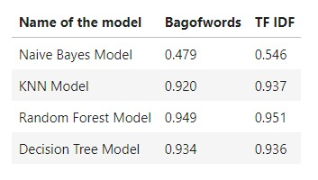
Machine learning models
This table shows the performance of different machine learning models using two different feature extraction techniques - Bag of Words and TF-IDF.
The table shows the accuracy of each model when using Bag of Words and TF-IDF as the feature extraction technique. It appears that the TF-IDF feature extraction technique performs better than Bag of Words for all the models listed. The Random Forest Model has the highest accuracy score for both feature extraction techniques.

Slide 20
Tableau Visualization

Slide 21
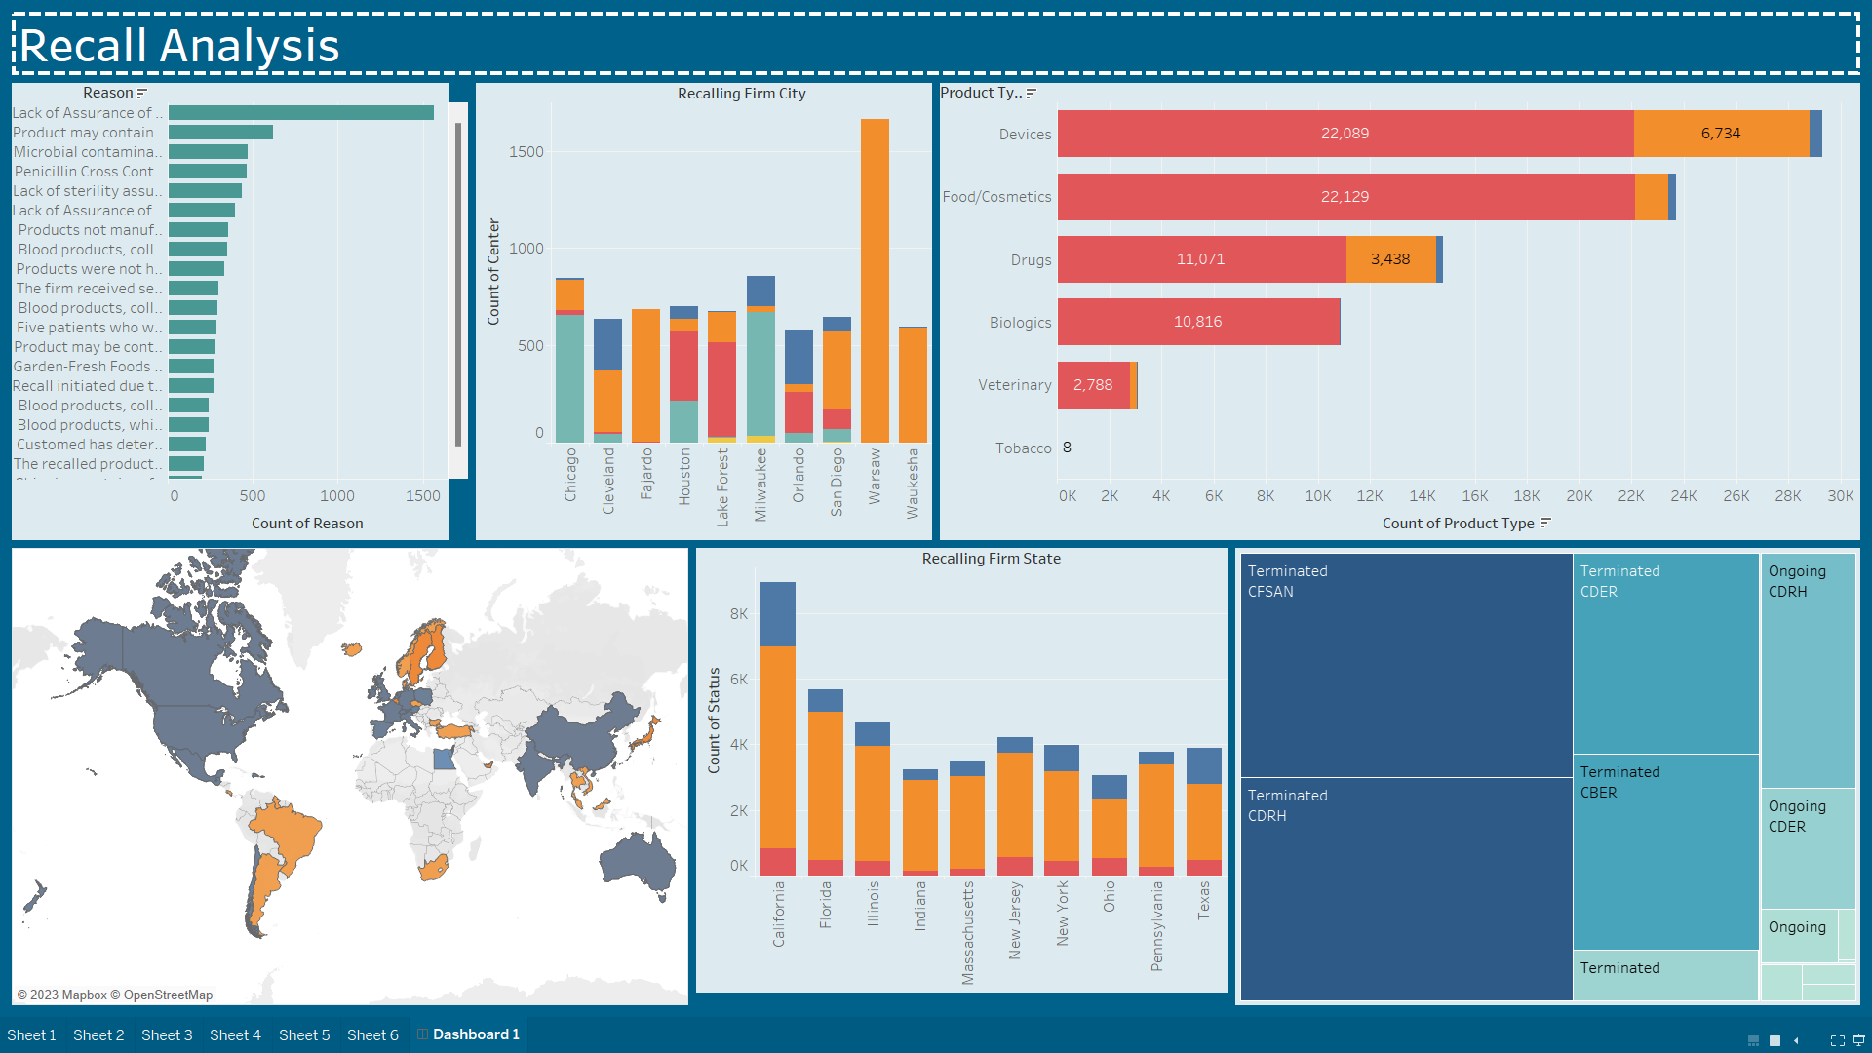

Slide 22
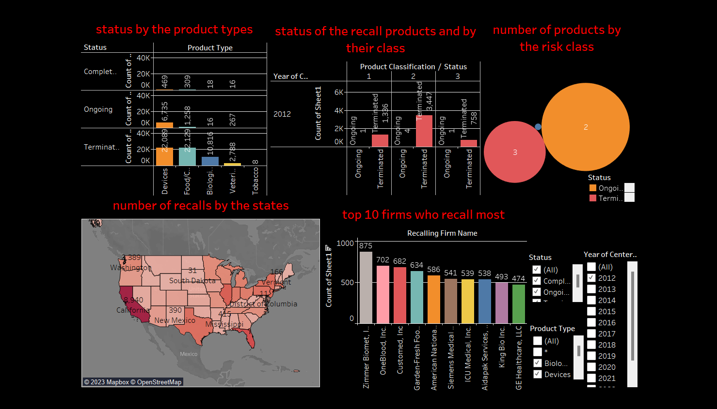

Slide 23
Thank you

